Slide 1





ABYA YALA
FREDOOM FIGHTERS
SAVE THE LAND AND RECOVER THE GOLD

Slide 2

AGENDA
Game Summary
Level Scene Design
Mechanics

Slide 3
ABYA YALA
FREDOOM FIGHTERS
Genre: Action-adventure, side-scrolling platformer.
Story: Colonizers have attacked an Indigenous village, stealing gold and destroying the land. Brave defenders must chase them into the forest to get the gold back and protect their home.

Slide 4
Victory: The player wins by:
Recovering most of the stolen gold.
Defeating all soldiers/colonizers in the current level.
Defeat: The player loses if:
All lives are lost (no more health and lives left).
Time runs out, and the soldiers/colonizers successfully escape with the gold or secure control over the forest.

Slide 5
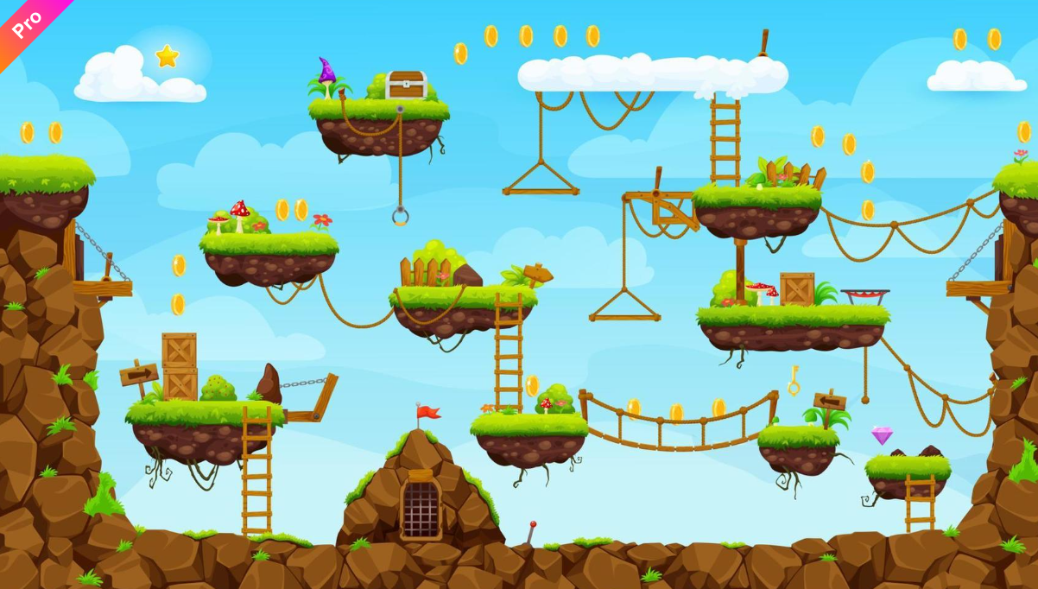



LEVEL SCENE DESIGN
CHARACTERS
ENEMIES
TAKEN FROM: ITCH.IO, VECTEEZY

Slide 6
MECHANICS
Movement Mechanics
Walking/Running: Players can move left or right
Jumping: Players can leap over obstacles or onto platforms, with jump height.
Combat Mechanics
Melee Attacks: Close-range combat with knives.
Ranged Attacks: Arrows follow trajectories, requiring aim adjustment for distance and gravity.
Enemies attack with guns, providing a tactical challenge.

Slide 7
MECHANICS
Resource Management
Gold Collection: Gold is automatically collected when players overlap with it or press the interact key.
Gold Loss: If the player loses a life, the collected gold permanently disappears
Progression Mechanics
Lives: Players have five lives; losing all results in game over.
Limited Time: Each level has a time limit, encouraging strategic decision-making.
Power-Ups: Temporary boosts to stats like increasing a life.

Slide 8
THANK YOU
END

